Slide 1
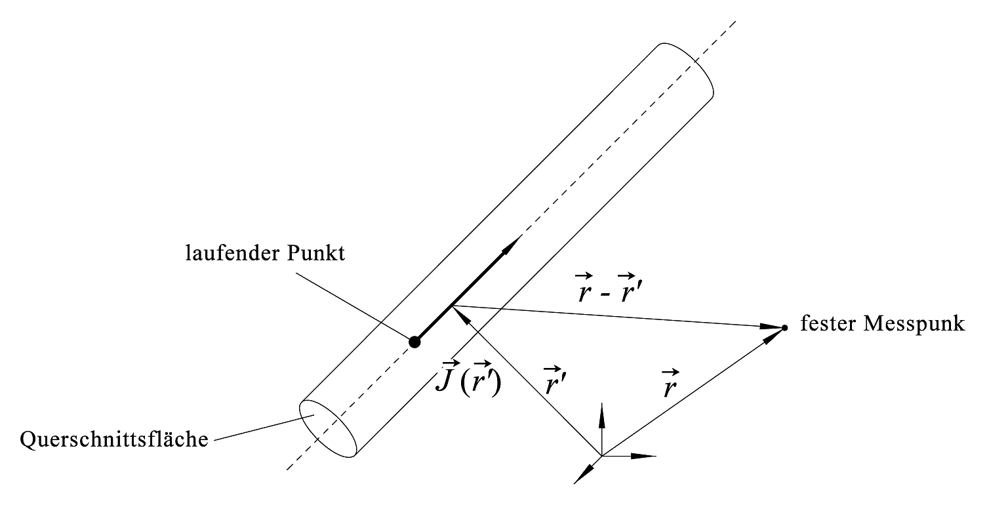
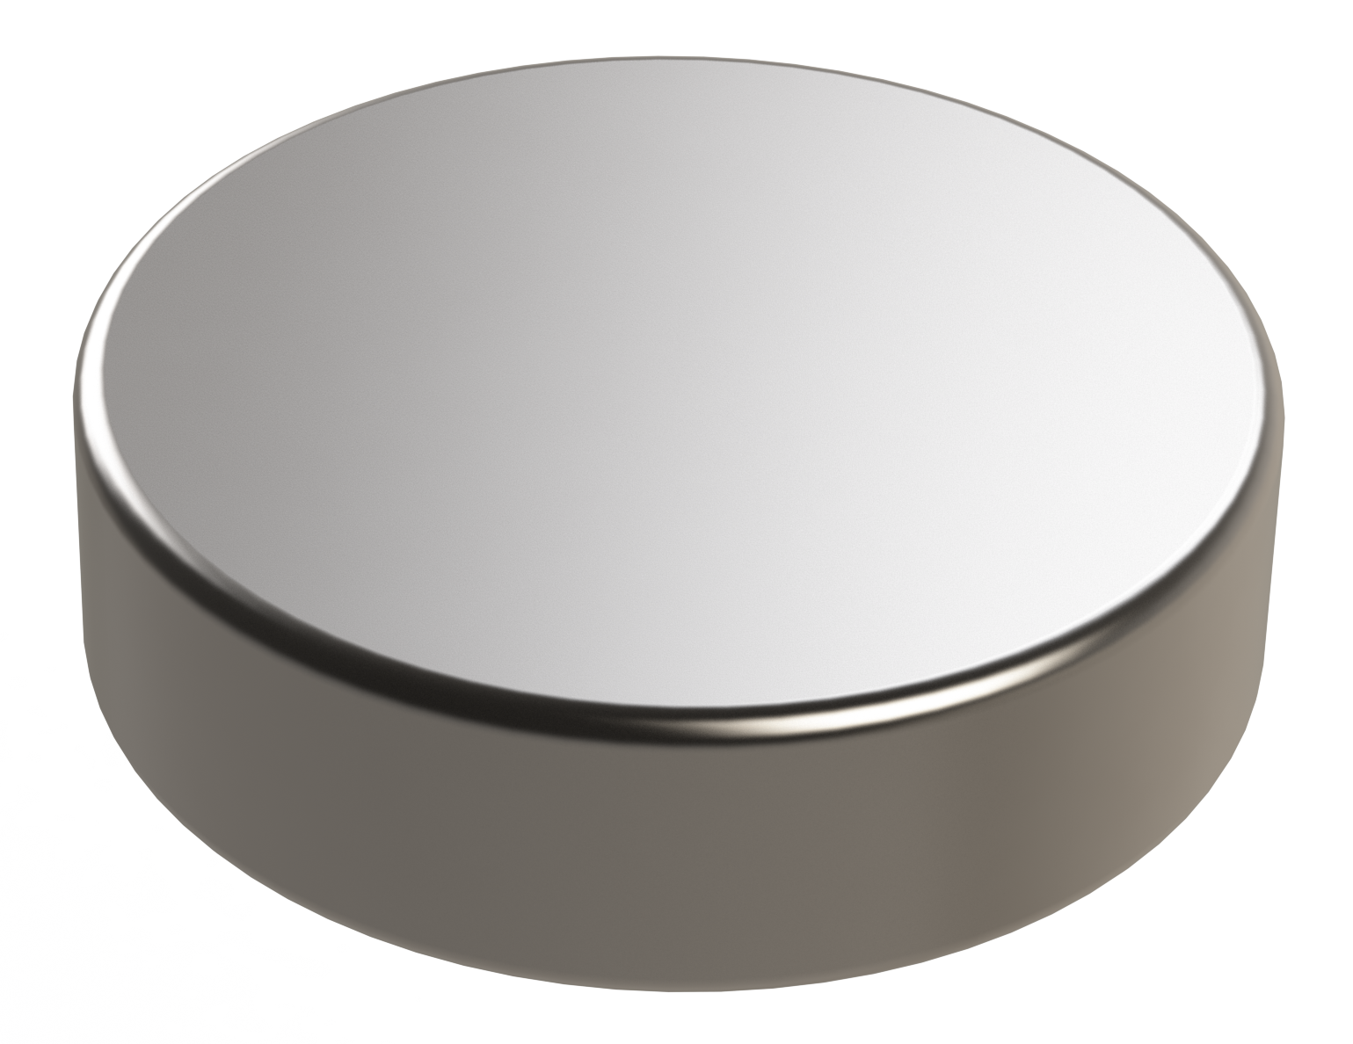
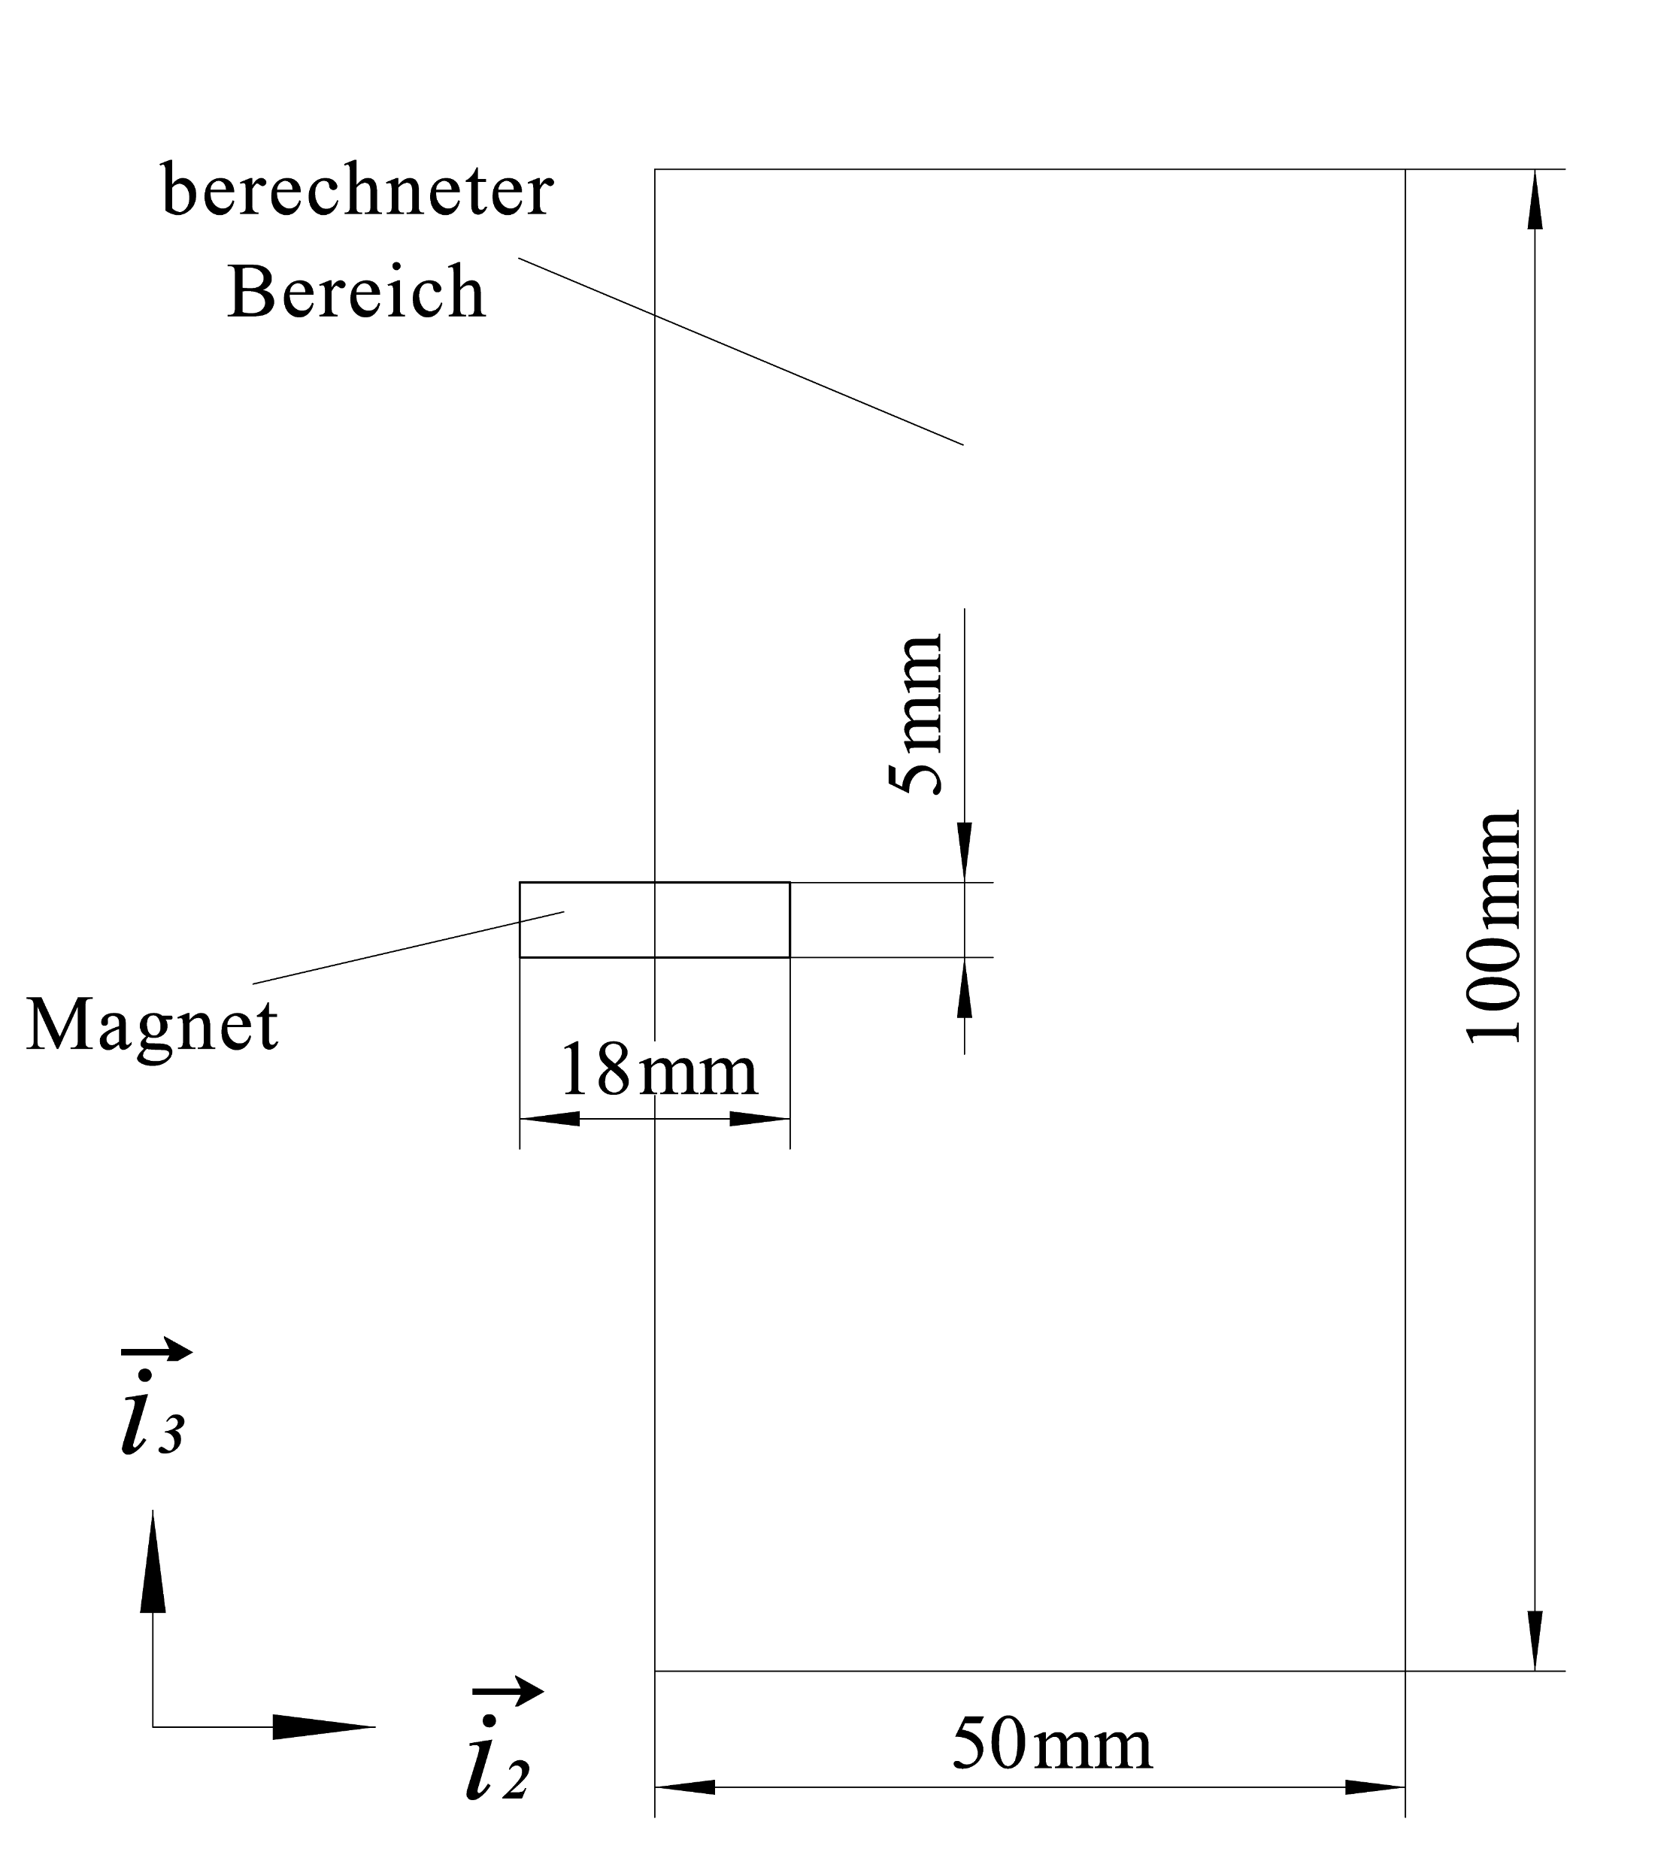
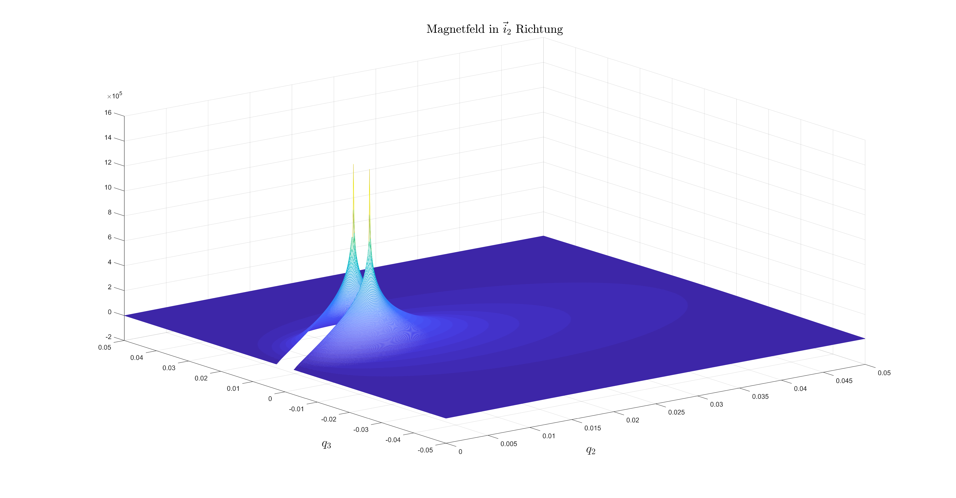
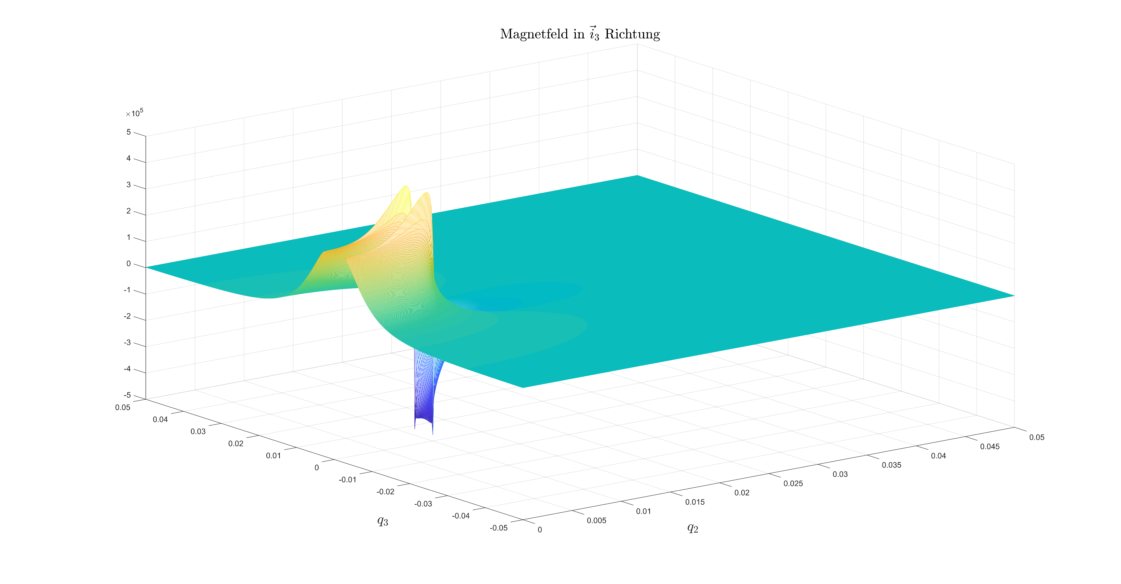
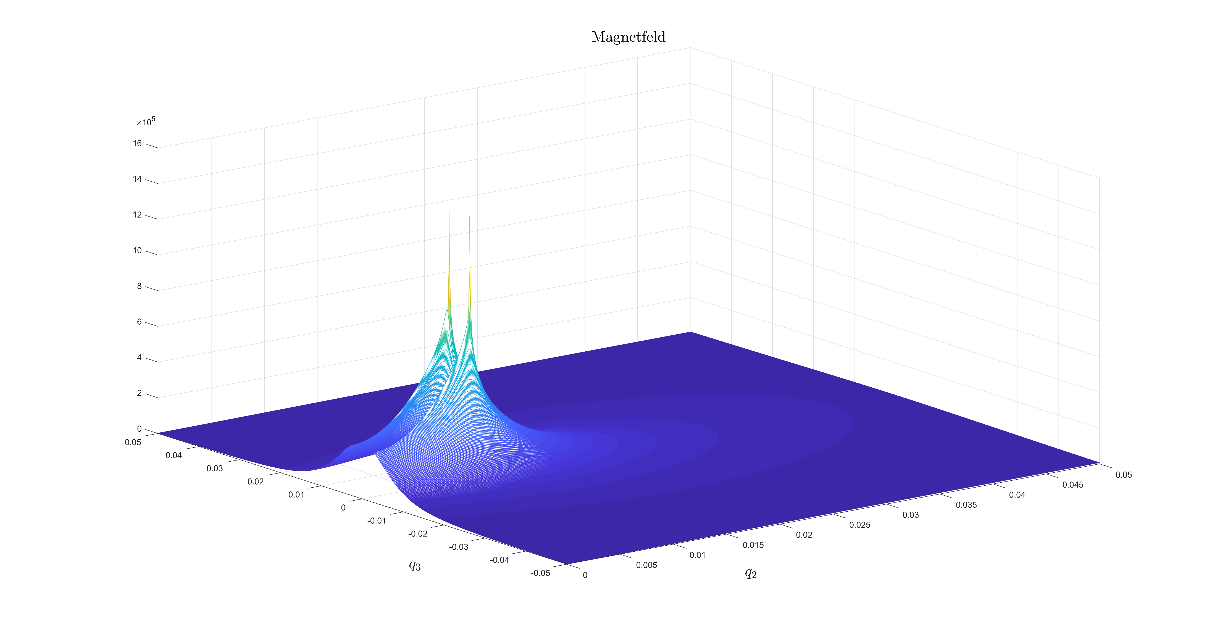
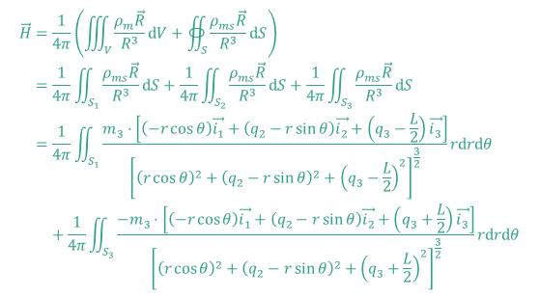
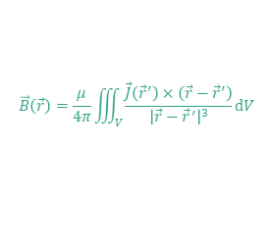
Magnetic Tracking System
Goal
Position and Orientation of a Magnet.
Plan
Magnet Modelling → Sensorsystem Design and Analyzation → Tracking Algorithms → Realization
Magnet Modelling
$$\begin{aligned}\vec{H}=&\frac{1}{4π}\left(\iiint_{V}{\frac{ρ_{m}\vec{R}}{R^{3}}dV}+∯_{S}{\frac{ρ_{ms}\vec{R}}{R^{3}}dS}\right) \\ =&\frac{1}{4π}\iint_{S_{1}}{\frac{ρ_{ms}\vec{R}}{R^{3}}dS}+\frac{1}{4π}\iint_{S_{2}}{\frac{ρ_{ms}\vec{R}}{R^{3}}dS}+\frac{1}{4π}\iint_{S_{3}}{\frac{ρ_{ms}\vec{R}}{R^{3}}dS} \\ =&\frac{1}{4π}\iint_{S_{1}}{\frac{m_{3}⋅\left[（−r\cos{θ}）\vec{i_{1}}+\left(q_{2}−r\sin{θ}\right)\vec{i_{2}}+\left(q_{3}−\frac{L}{2}\right)\vec{i_{3}}\right]}{{\left[{\left(r\cos{θ}\right)}^{2}+{\left(q_{2}−r\sin{θ}\right)}^{2}+{\left(q_{3}−\frac{L}{2}\right)}^{2}\right]}^{\frac{3}{2}}}rdrdθ} \\ &+\frac{1}{4π}\iint_{S_{3}}{\frac{−m_{3}⋅\left[（−r\cos{θ}）\vec{i_{1}}+\left(q_{2}−r\sin{θ}\right)\vec{i_{2}}+\left(q_{3}+\frac{L}{2}\right)\vec{i_{3}}\right]}{{\left[{\left(r\cos{θ}\right)}^{2}+{\left(q_{2}−r\sin{θ}\right)}^{2}+{\left(q_{3}+\frac{L}{2}\right)}^{2}\right]}^{\frac{3}{2}}}rdrdθ}\end{aligned}$$
Magnet Modelling
$$\vec{B}\left(\vec{r}\right)=\frac{μ}{4π}\iiint_{V}{\frac{\vec{J}\left({\vec{r}}^{′}\right)×\left(\vec{r}−{\vec{r}}^{′}\right)}{{\left|\vec{r}−{\vec{r}}^{′}\right|}^{3}}}dV$$
Magnet Field Distribution

Slide 2
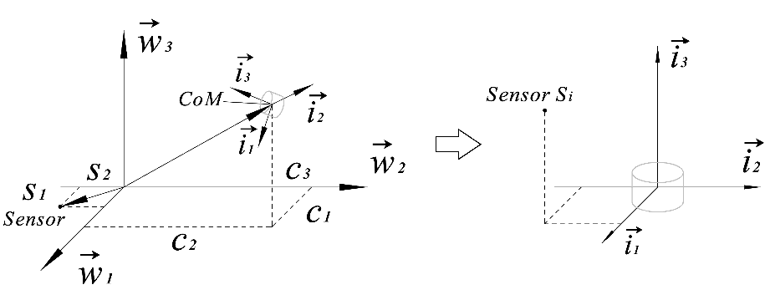
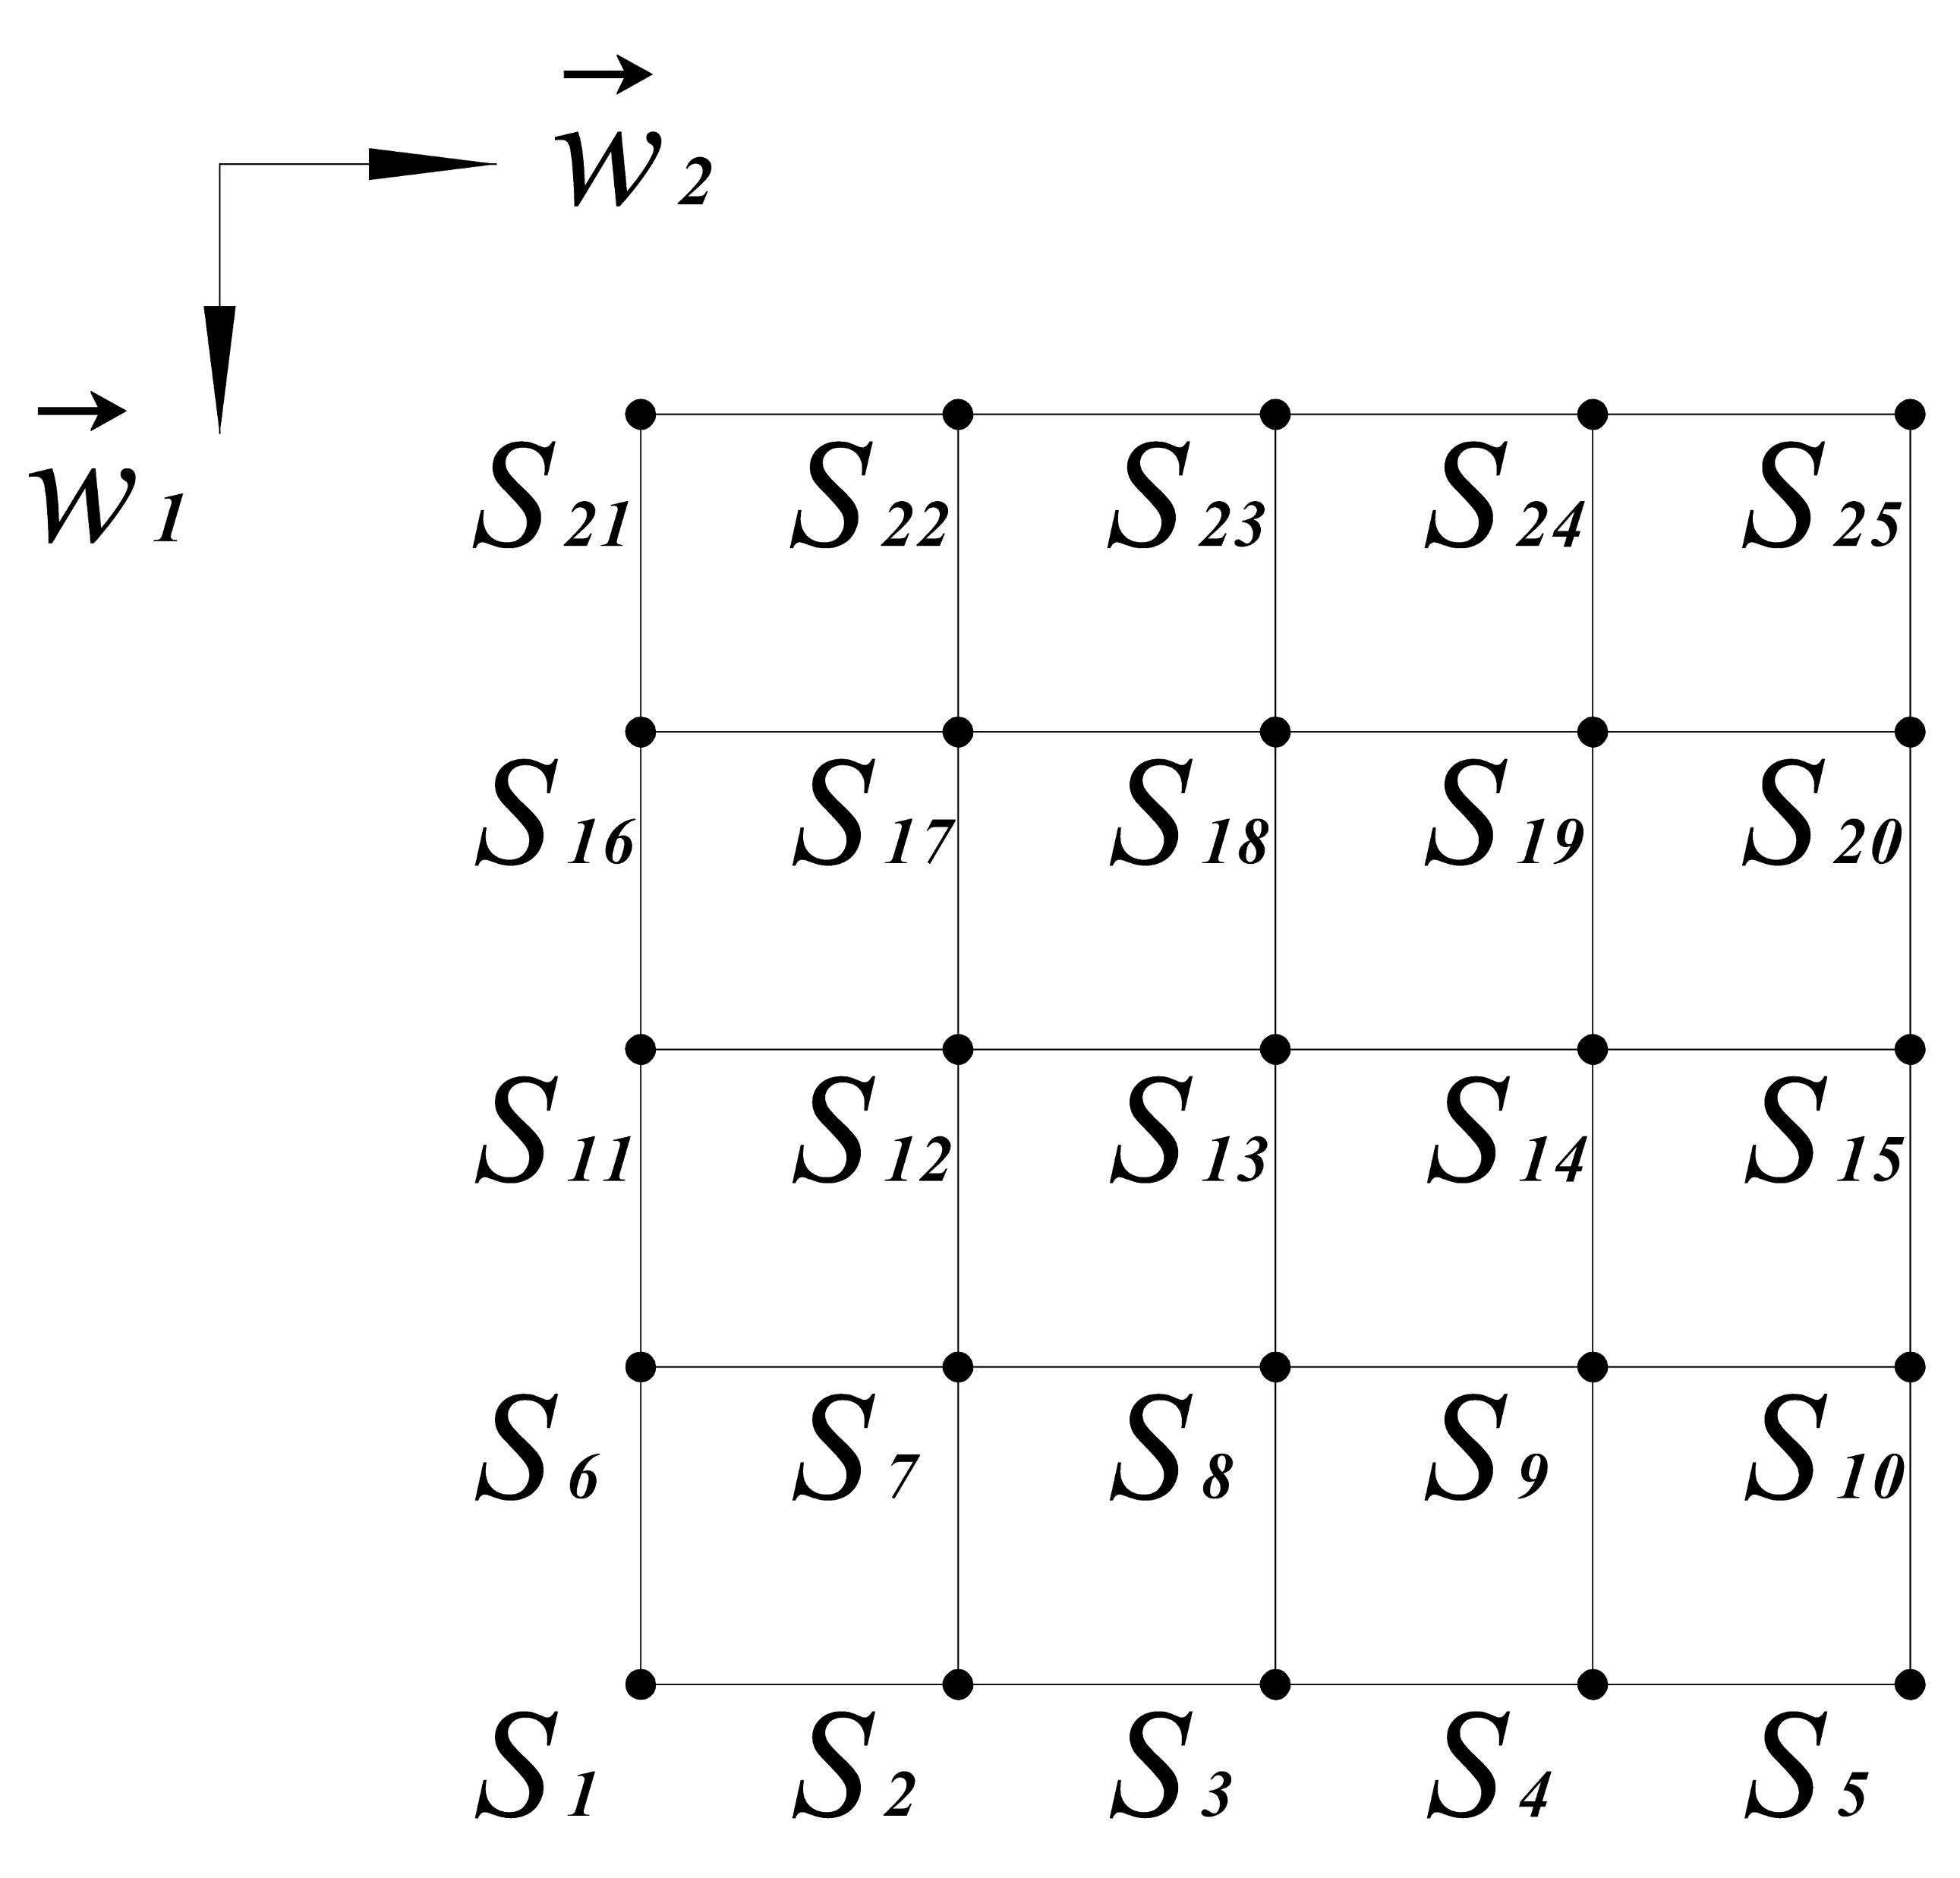
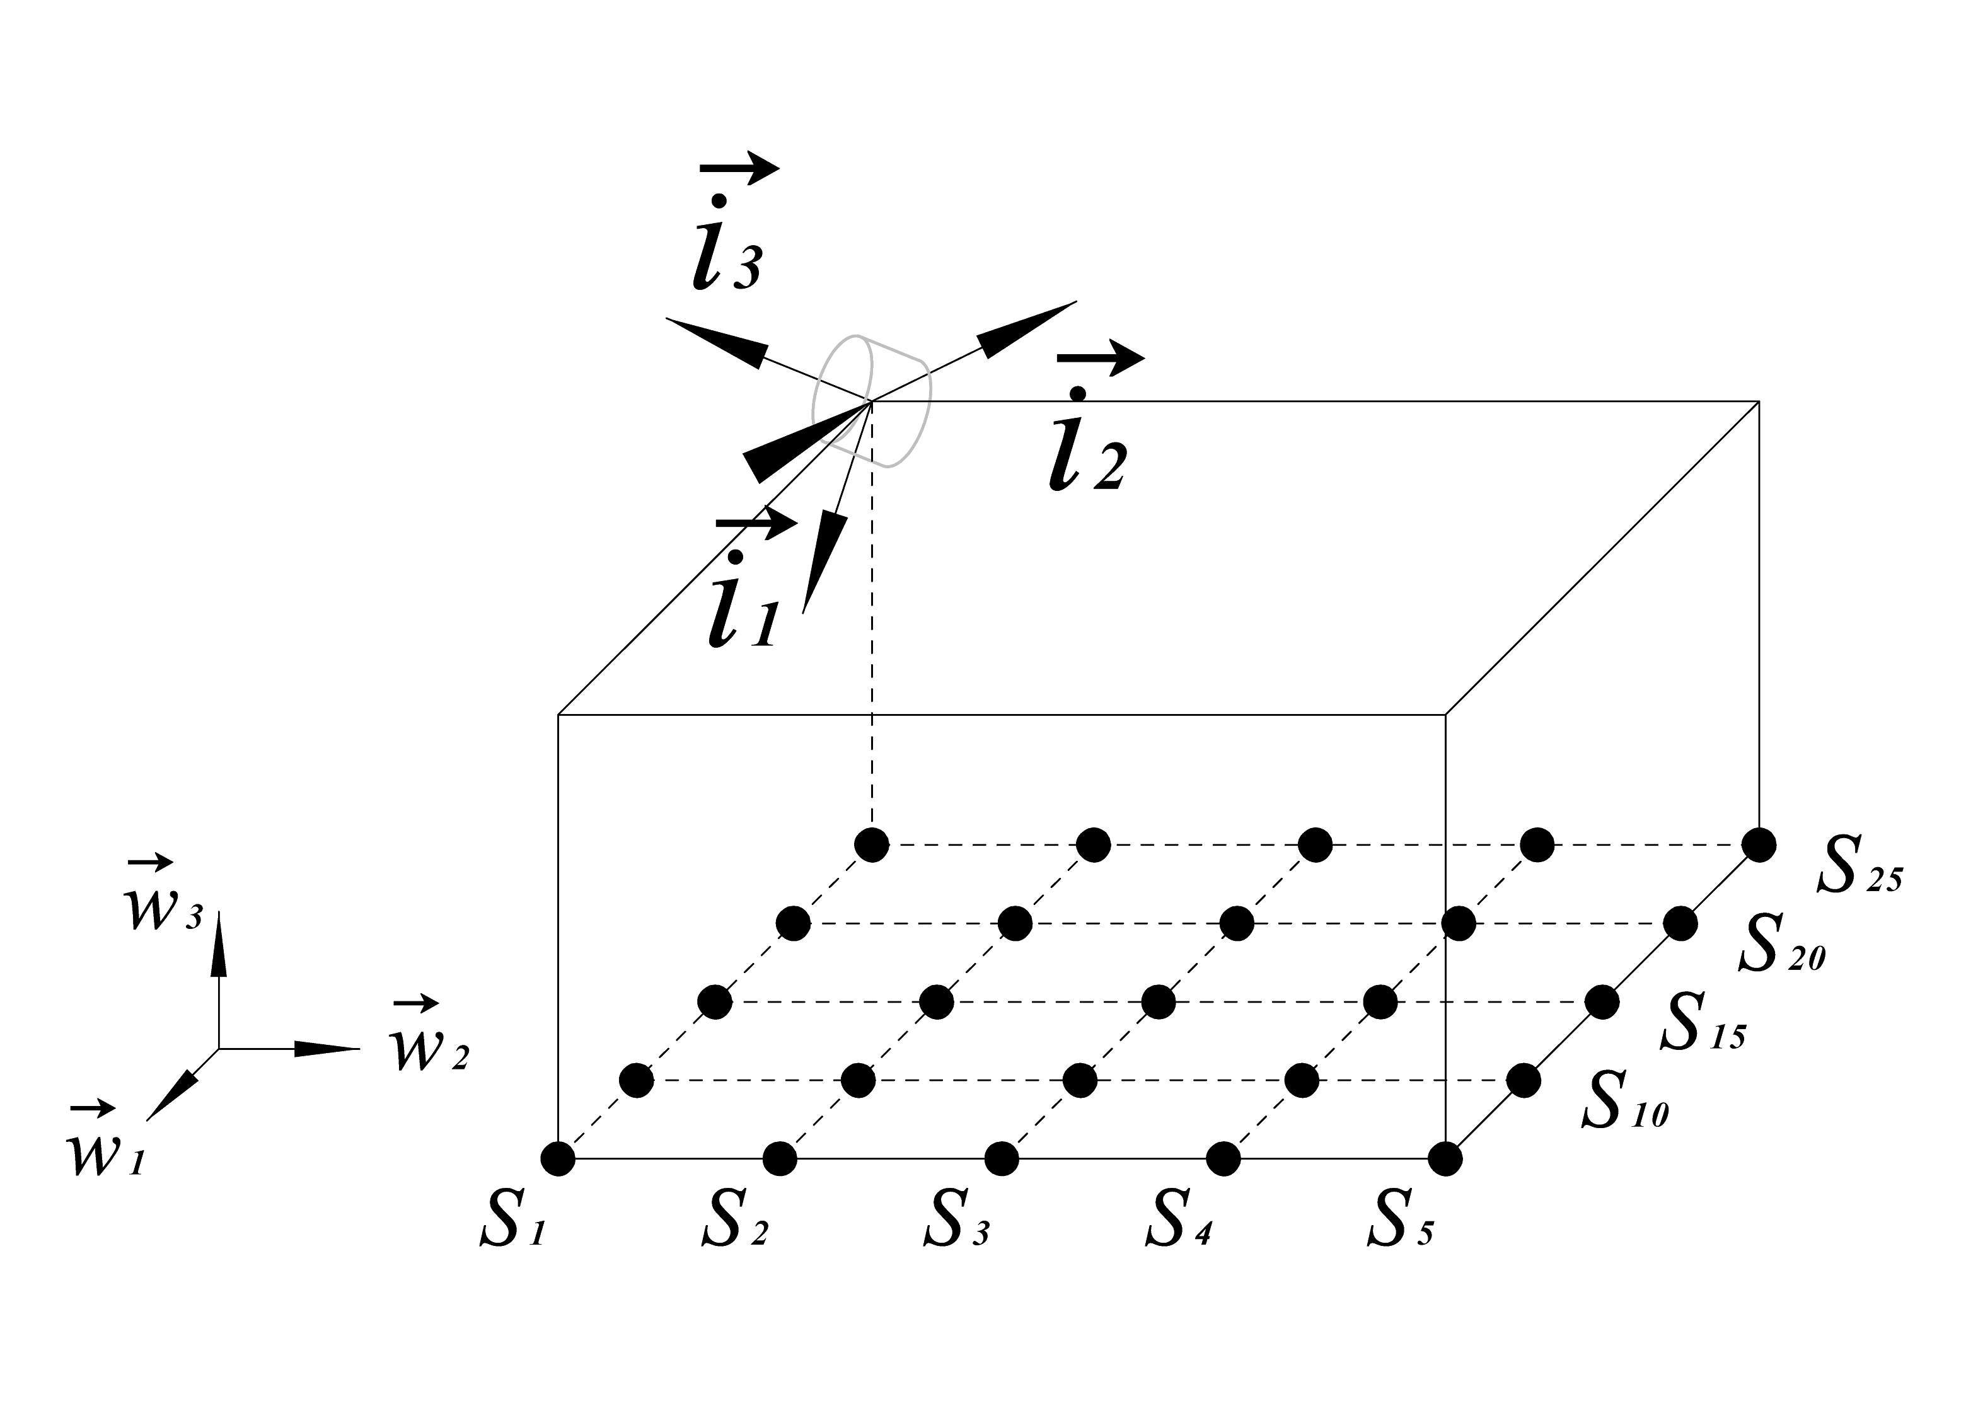
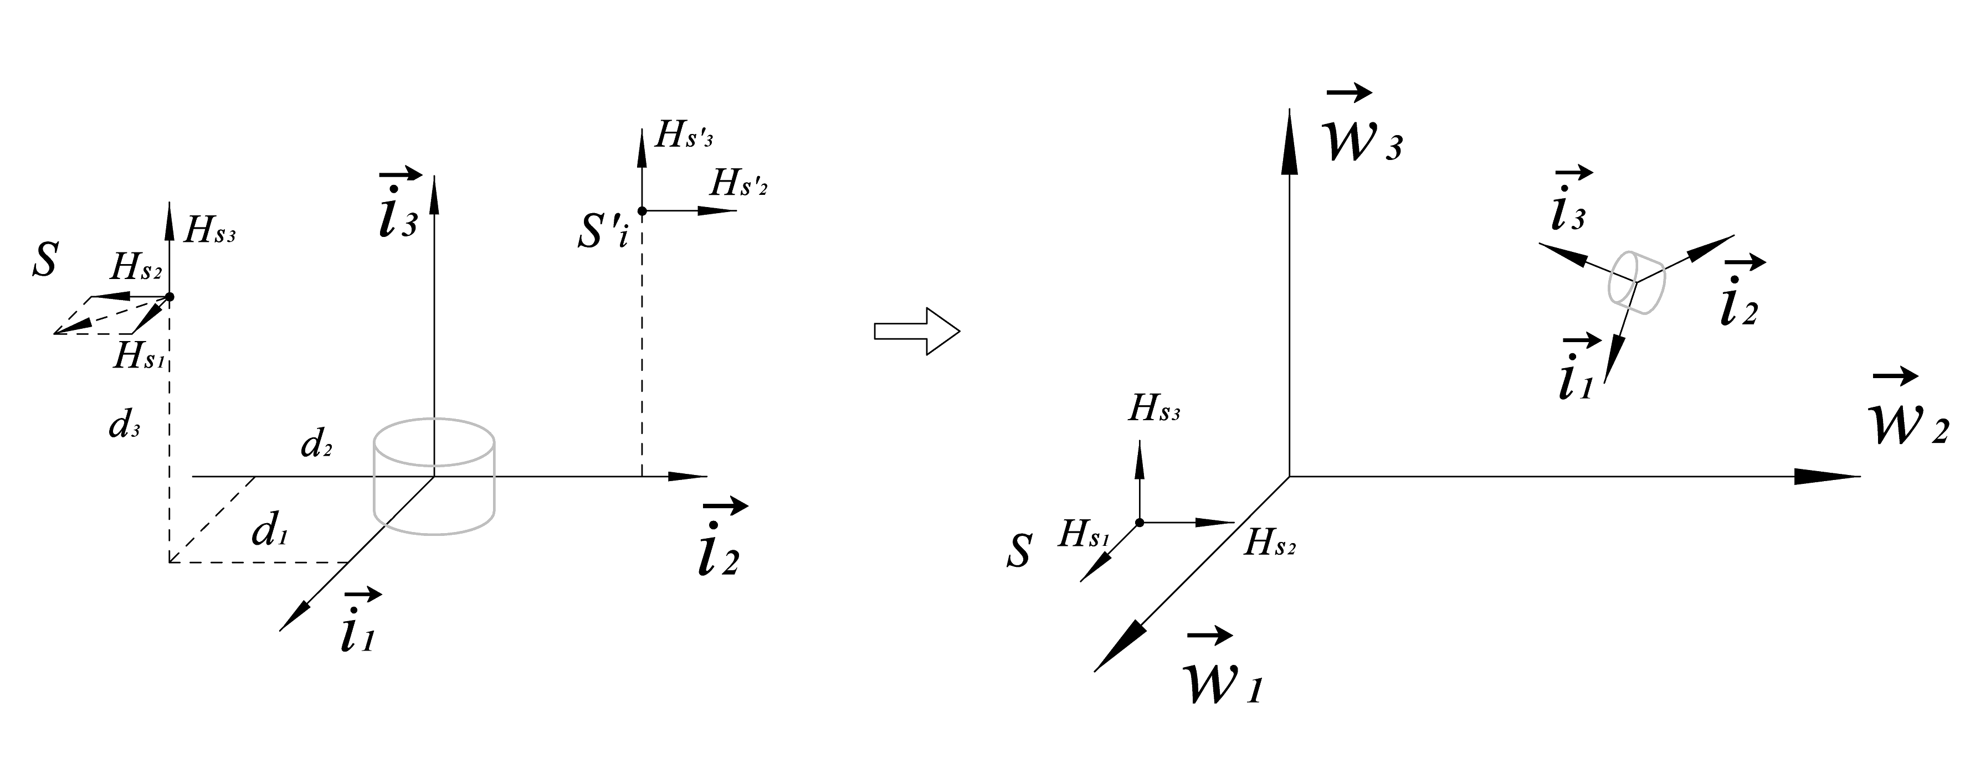
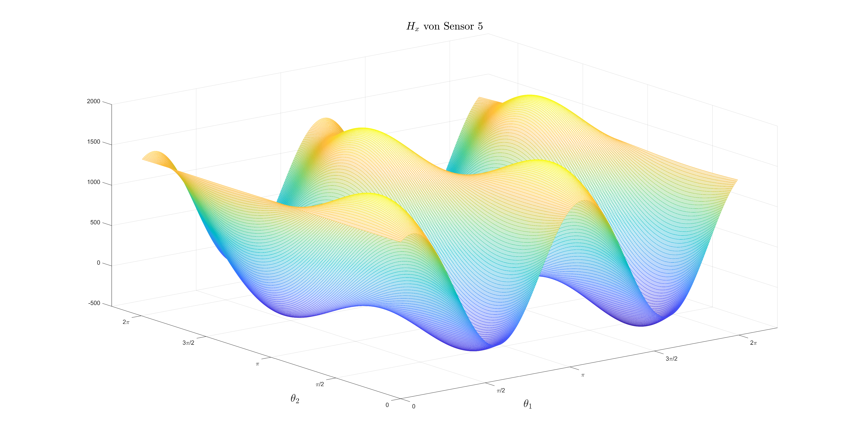
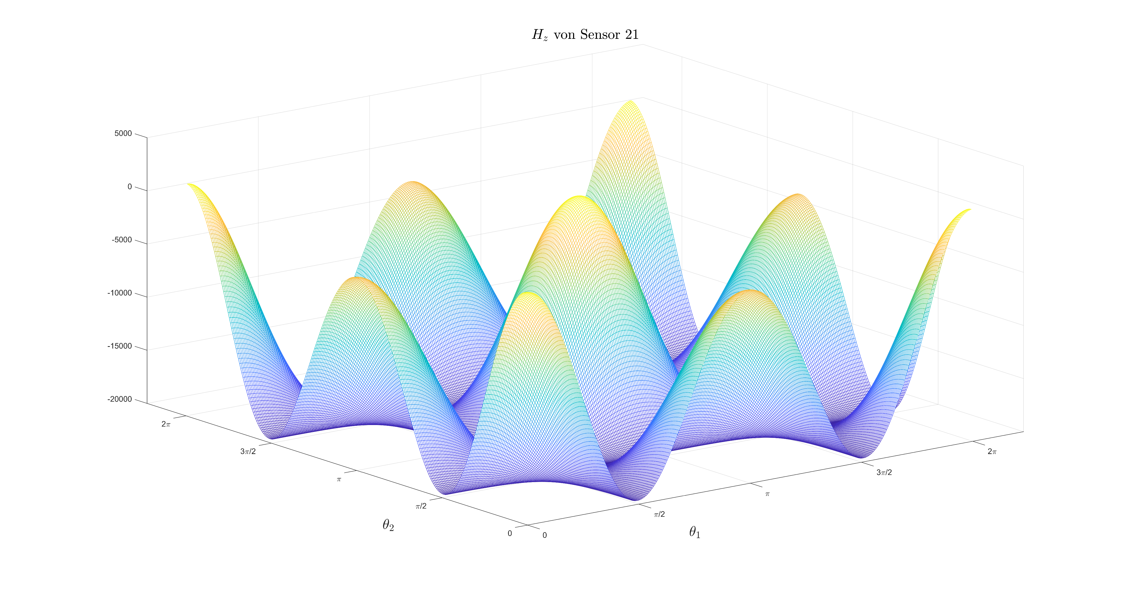
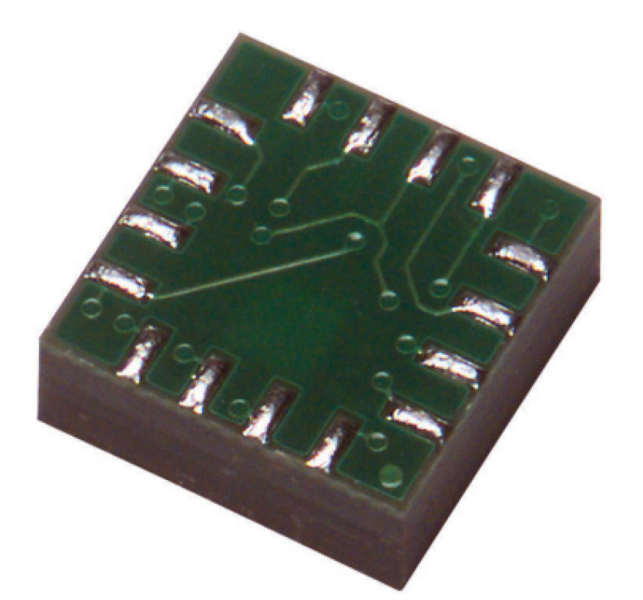
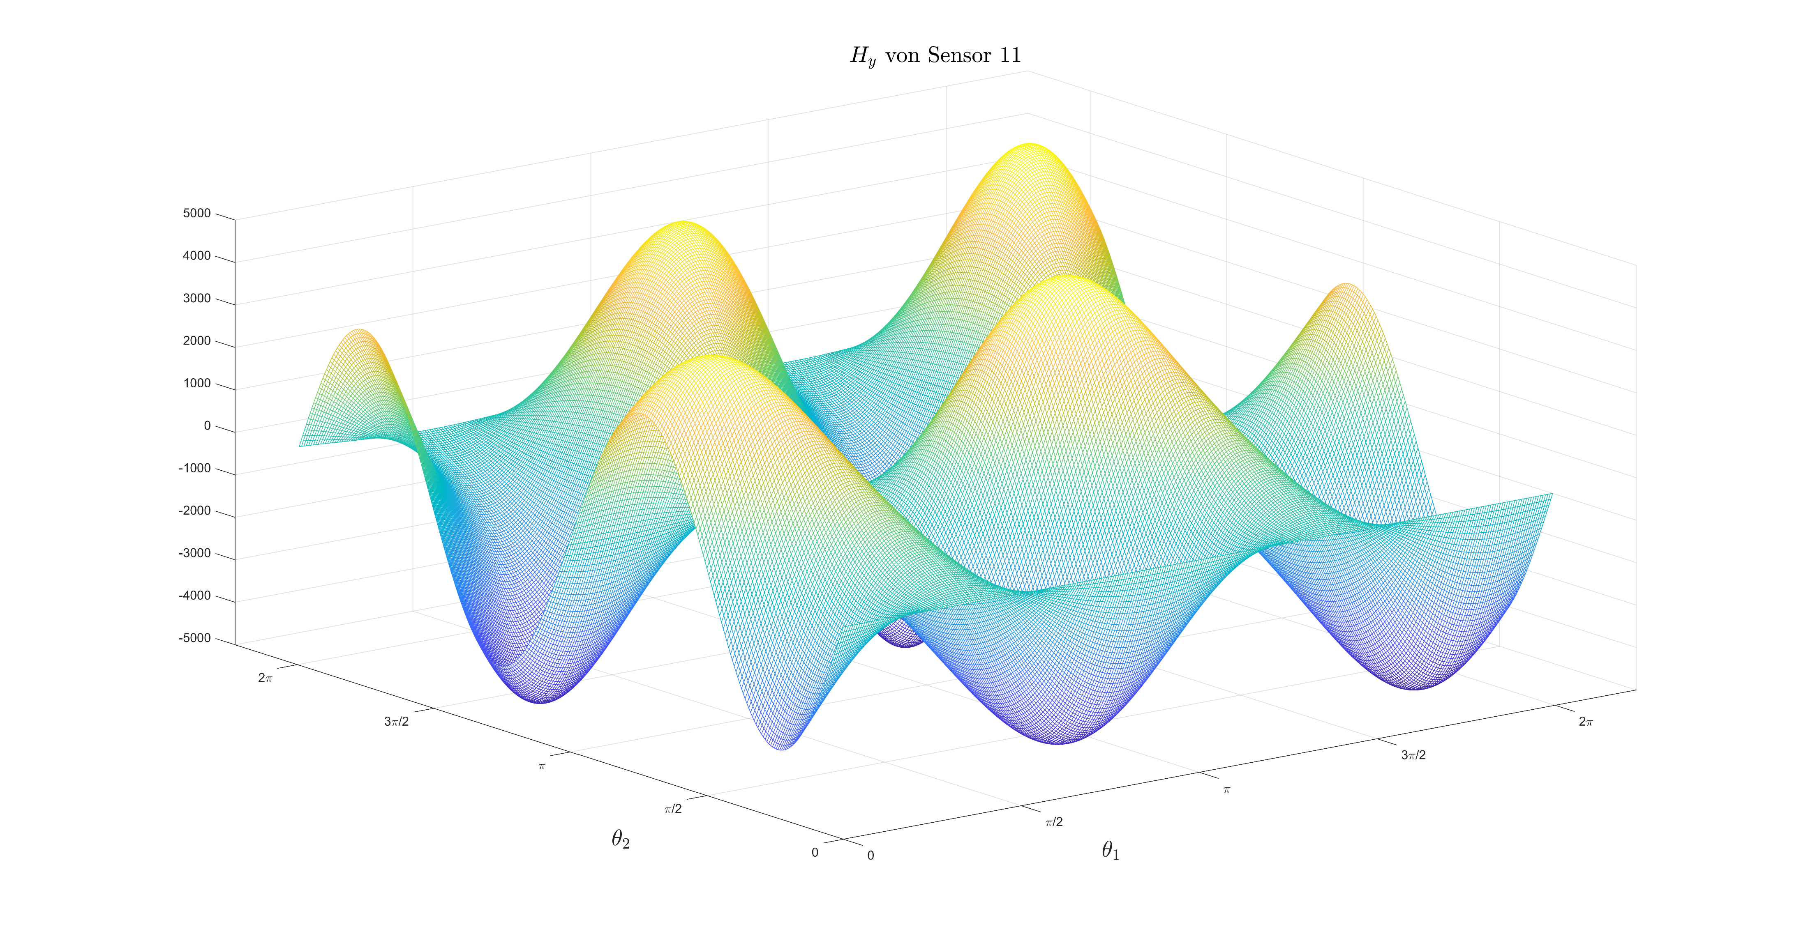
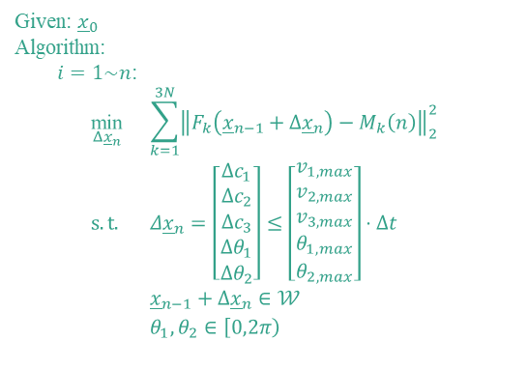
Magnetic Tracking System
Sensor and Sensor Array
Design of the Sensor Array
How many Sensors are needed
Position and Orientation of each Sensor
Hall Sensor Selection
Accuracy
Resolution
Range
Analysis of the Sensor System
Honeywell HMC1053
Resolution
Accuracy
Given: ${\underline{x}}_{0}$
Algorithm:
$i=1\sim n$:
$$\begin{aligned}&\underset{Δ{\underline{x}}_{n}}{\text{min}}{}&&\sum_{k=1}^{3N}{{\left\|F_{k}\left({\underline{x}}_{n−1}+Δ{\underline{x}}_{n}\right)−M_{k}\left(n\right)\right\|}_{2}^{2}} \\ &s.t. &&Δ{\underline{x}}_{n}=\left[\begin{aligned}Δc_{1} \\ Δc_{2} \\ Δc_{3} \\ Δθ_{1} \\ Δθ_{2}\end{aligned}\right]≤\left[\begin{aligned}v_{1,max} \\ v_{2,max} \\ v_{3,max} \\ θ_{1,max} \\ θ_{2,max}\end{aligned}\right]⋅Δt \\ &&&{\underline{x}}_{n−1}+Δ{\underline{x}}_{n}∈𝒲 \\ &&&θ_{1},θ_{2}∈\left[0,2π\right) \\ &&\end{aligned}$$
Development of Tracking Algorithm
Difficult:
Inverse Kinematic not available
Input Information not available
Basic Idea:
Initialization before running the System, and then
Transform the Problem into a 5-dimensional Optimization Problem
Realization of the Tracking System

